Slide 1
supporting diagnostic decision for early detection of neurodegenerative diseases on a behavioural altered pattern basis
· BEDMOND project ·

Slide 2
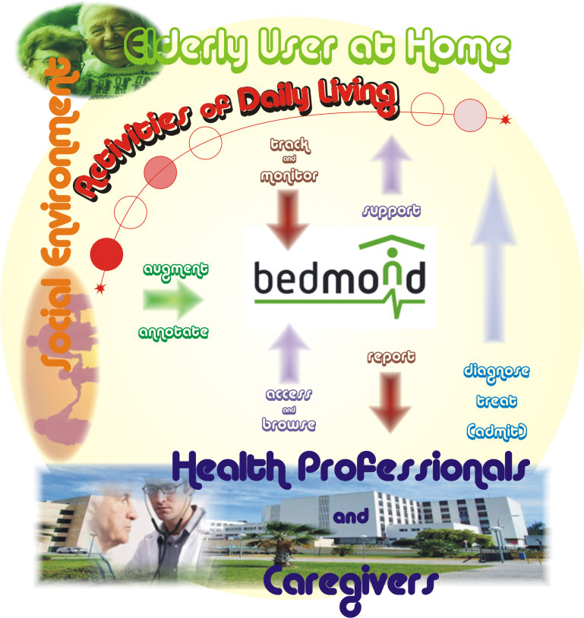
PRESENTATION OUTLINE
Background: Social, Science & Technology:
Nature of the problem
Previous work, Ways to tackle
Enabling Technologies
BEDMOND Project Scope:
Purpose
Requirements
Architecture
Reasoning & Intelligence (back-end)
Interacting Tools (front-end)
Conclusions:
Contribution
Next Steps

Slide 3
BACKGROUND: SOCIAL AND S&T Nature Of The Problem
Societal issues & needs:
Cognitive Decline while ageing → High social cost when pathological:
Patients: 24 million in the world, 6 in Europe, 0.6 in Spain → 10% of people 65+ and 50% 85+
Increasing life expectancy → epidemic
USA: nearly 15 million Alzheimer’s and dementia caregivers:
17 billion hours of unpaid care (valued at $202 billion)
$7.9 billion in additional health care costs in 2010
Quality of Life, Autonomous & Independent → Personal wish

Slide 4
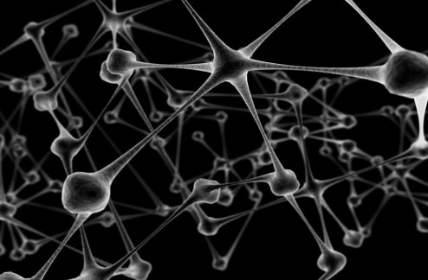
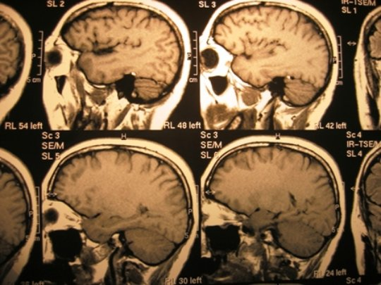
BACKGROUND: SOCIAL AND S&T Previous Work
Searching the origin (causes) of the problem,
Still unknown → Only proven fact: breaking links among brain cells → neurons coming to death
But WHY? → Genomics, Proteomics, Metabolomics
Correct way but, OTHER WAYS?
Disease evolution is WELL KNOWN → MCI
Changes in ADL : potential MCI prodromes
EARLY DETECTION ?
Behaviour modelling and recognition techniques
MCI symptoms characterization
Behaviour & MCI symptoms monitoring techniques

Slide 5
BACKGROUND: SOCIAL AND S&T Fundamental Assumptions
Normal Ageing
SANE
ILL
MCI is a concept in the boundary or transitional state between aging and dementia, the earliest stage of dementia
Some changes in daily behaviours and routines are reported as MCI symptoms
Ageing associated memory impairment
Ageing associated cognitive decline
1
Mild Cognitive
Impairment
2
Dementia
Early stage
Ambient Assisted Living technology can do the job!
Stable or Reversible Impairment
Middle stage
Late stage
Physicians need more objective information about daily routines for early diagnosis …
Normal cognition
Brain Ageing
Early detection
=
Longer independent life
(treatment)
Prodomal dementia
reversible
Mild Cognitive
Impairment
Stable or reversible impairment
3
4
Dementia
Vascular dementia
mixed
Alzheimer’s disease
mixed
Other dementias
… and reduction of high costs of institutionalization

Slide 6
BACKGROUND: SOCIAL AND S&T Fundamental Assumptions: 1st conclusions
Neurodegenerative diseases, specially Alzheimer, are a great problem in our ageing society
Certain progressive changes in elders’ behaviour pattern are symptomatic of the beginning of a cognitive disease
They appear namely in 5 domains,
Memory
Orientation
Judge & solving
Home & hobbies
Community affairs
When early detected, doctors can prolong life expectancy of the person by slowing the disease progression
Behaviour Pattern
Recognizing
Modelling
Tracking
Analising deviations

Slide 7
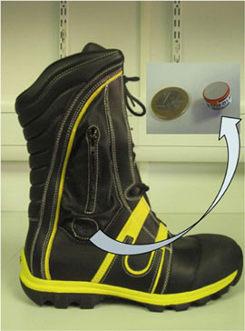
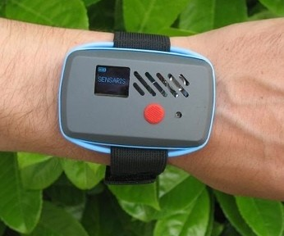
BACKGROUND: SOCIAL AND S&T Enabling Technologies
Smart homes (AmI → AAL)
Teleassistance
Communications (wireless)
Sensoring ambient & home objects,
In → Embedded (smart objects)
Out → off-the-shelf sensors attached
Sensoring the person,
Wearable (clothes, personal objects, body)
Medical devices for personal use
Assistive & Adaptive Technology

Slide 8
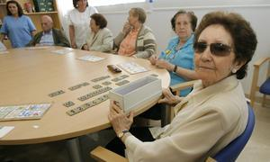
BACKGROUND: SOCIAL AND S&T Enabling Technologies
Simple behaviour models,
Recognizing frequent but simple stored behaviours and acting consequently
Complex behaviour models,
Modeling behaviour pattern,
Daily Activities: what & how he does
Routines: when he does
Long learning process → valid model
Tracking daily behaviour,
Calculating deviations,
Interpreting deviations

Slide 9
BACKGROUND: SOCIAL AND S&T Conclusions
Medical-Scientific proven knowledge (evidences),
MCI → early detected → longer autonomous life expectancy
Cost-effective Health Public System requirement,
Elders wishes,
Live at own home → NOT institutionalization (latest),
AAL ICT-based Enabling Technologies,
Tele-assistance,
Smart-home tech
Mobile tech
Tele-medicine
Detailed Routines
(indoor & outdoor)
ICTs,
Activity Modelling
Data Interpretation
Info Presentation
Daily Activity
&
Health Condition
(tele)monitoring
Physical & Emotional

Slide 10
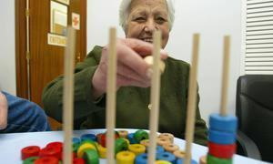
BEDMOND Project Scope Purpose
“ICT-based system for an early detection of Alzheimer’s disease and other neurodegenerative diseases, focused in elderly people while living at home”
“With such an early detection, health professionals can later on apply an early pharmacological treatment which is proven to delay Alzheimer’s disease appearance and, consequently, help the elder to live longer independently at home.”

Slide 11
BEDMOND Project Scope Purpose
a main support tool for medical experts addressed to the early diagnosis of neurodegenerative diseases through behavioural changes analysis, based on smart-home and tele-assistance technologies
a tool for the caregivers at home to inform and be informed about the last activities’ performance
an alert tool to inform about home alarm signals and react quickly on high risky situations
While still sane
PRE
DIAGNOSIS
NEURO
DEGENERATIVE
DISEASES
(MCI)
POST
DIAGNOSIS
Once in treatment

Slide 12
BEDMOND PROJECT SCOPE Requirements – AAL Guidelines
The project’s goals involve the concepts of user, product and exploitability as overall requirements:
Combining and integrating technologies (not researching – AAL JP compliant)
Unobtrusive low-cost sensors
Getting a ready-to-market-product in one year time after project
Friendly interface
Add value for all the users involved
User involvement & acceptance
Data: Privacy and safety guaranteed

Slide 13
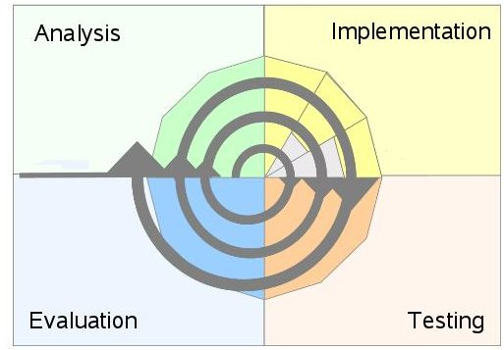
BEDMOND PROJECT SCOPE Requirements – User Involvement
User acceptance means that system fits the following:
Iterative Design & Development Process
Requirement Specification
Test & Validation
Ethical Watch

Slide 14
BEDMOND PROJECT SCOPE Requirements
Requirements acquisition process regarding the behaviour pattern to model & track
Behaviours collected from health professionals experience | Freq. (%)
Forgets what day it is | 57.9
Reduction of attention | 52.6
Loses, misplaces, or hides things | 47.4
Forgets medical appointments, important dates (birthdays), or taking medication | 47.4
Reiterative behaviour (ask the same question continuously, to do the same action repeatedly,…) | 47.3
Increased strategies to conceal the errors (self-justification) | 47.3
Difficulty with coordination and organization (Problems to do the cooking, shopping,…) | 47.3
Difficulties in coming up with the correct word so they use words like: “give me that” instead of “give me the plate” | 42.2
Lack of interest in things around him and abandonment of profitable activities | 42.1
Changes in personal hygiene (showering bad or refused, not wanting to shave...) | 42.1
Difficulty for a simple management of money | 42.1
To take much more time doing things and loss the time perspective | 42.1
Spatial disorientation: disoriented in the street or even at home | 36.9
Start but not finish things | 36.9
To be more restless or agitated than usual | 36.8
Changes of emotional status and they get angry easier | 36.8
…
Cualitative
& Quantitative
CONCLUSIONS
1
Routines & Activities of Daily Living in the one hand and, in the other hand, a set of symptomatic behaviours related to MCI
2

Slide 15
BEDMOND PROJECT SCOPE Architecture - Overview
Definition of the architecture of the BEDMOND system includes,
standards,
Sensors
Communications
interoperability,
modularity,
scalability

Slide 16
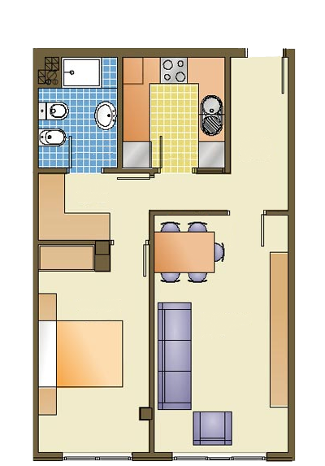
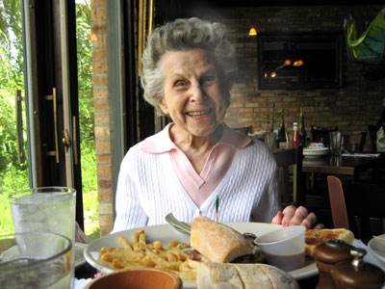
BEDMOND PROJECT SCOPE Architecture – Logic Process
Acquiring data
Pre-processing data
Post-processing data into information
Presenting info on screen (BEDMOND tools)
SMART HOME + TELECARE
BEHAVIOUR MODELLING ALGORITHMS & STATISTICS
INTELLIGENT SOFTWARE FOR DATA INTERPRETATION (RULES ENGINE)
SIMPLE & USER-ADAPTIVE INFO PRESENTATION
ELDER
Enhanced Risk–at-Home Manager
Technical alarms, appliances, doors, windows
Behaviour Model
Routine patterns for ADLs
sleep→ breakfast → personal care → home tiding → shopping → …
Deviations Calculation over Routine Patterns
Continuous Behavioural Monitoring
(daily activity tracking at home)
MCI Symptoms Detection
In-home Risky Situations
CAREGIVER
Remote Information System (elder’s activity)
Periodically informed, eventually informing HCP
Mild Cognitive Impairment Symptoms Tracking & Warning
Oversights, disorientation, loss of personal objects, isolation & loneliness, lack of interest, …
Interpretation (medical expertise)
Daily routine analysis & attention tosituations associated to the executive function
1st. Classification into Cognitive domains:
Memory
Disorientation
Judge & Problem Solving
Community Affairs
Home & Hobbies
Hygiene and Personal care
2nd. Evaluation
(Screening):
Red
Yellow
Green
CDR*
Scale
1
0.5
0
Vital Signs Monitoring
(medical devices for personal use)
Significant change → MCI
DOCTOR (HCP)
PRE-DIAGNOSTIC
INFORMATION
Decision-making support Assistant
Barely change → Very MCI
No change→ Sane
Detailed Health Status Evolution
: Sensors at home
ADL: Activities of Daily Living
MCI: Mild Cognitive Impairment
CDR Scale: Clinical Dementia Rating scale
HCP: Health Care Professional (physician)

Slide 17
BEDMOND PROJECT SCOPE Reasoning & Intelligence (back-end)
The Behaviour Monitoring System (BMS) will be the core component of the BEDMOND platform,
BMS is an intelligent system which will count with three main layers, upon the data acquisition:
Data-driven layer, for the situation recognition (low level layer)
Knowledge-driven layer, for the situation interpretation (high layer for intelligence)
Presentation layer, for interactions with the users (high layer for interactions)
BMS is partially a self-learning system concerning behaviour patterns.

Slide 18
BEDMOND PROJECT SCOPE Reasoning & Intelligence (back-end)
The low layer (data-driven aspects for situation recognition) for the Behaviour Monitoring System (BMS) represents the 1st step of BEDMOND’s core component,
Gets the raw data from home sensor network for later modelling the elder’s behaviour
Process that data to define and ticket daily activities and behaviours
Determines the behavioural pattern of the elder at home
Finally tracks the daily behaviour of the elder at home

Slide 19
BEDMOND PROJECT SCOPE Reasoning & Intelligence (back-end)
The high layer (knowledge-driven aspects for situation interpretation) represents the 2nd step of BEDMOND’s core component,
Interprets deviations when comparing daily activity with behavioural pattern, to detect an early stage of dementia,
Transforms intelligently the situation recognition info into ‘professionalized’ information for the health professional,
Uses health professionals’ rules and criteria,
Finally, presents an adequate and intuitively understandable user interface for all end-users.

Slide 20
BEDMOND PROJECT SCOPE Reasoning & Intelligence (back-end)
SITUATION RECOGNITION
BASIC REASONING
(Basic layer)
Data Acquisition and first info processing
Home Events:
· Technical alarms
· Risky Activities detected by a single ad-hoc sensor (front door open)
· Presence in a room
raw (unprocessed) data
LOW level layer
Data from single sensor events
basically processed data
Personal Events:
· Time based events (lying for a long time)
· # of times based events (open drawer)
Combining sensors
Other Events:
· Presence in sofa with TV on (watch TV)
· Open the basin faucet and bathroom light is on
Combining raw unprocessed data
Basic sensor data fusion
Sub-activities of Daily Life:
· Open the shower faucet for a while and bath’ presence (heating shower)
· Presence with bed sensor off and early in the morning: (getting up from bed)
Combining basically processed data

Slide 21
BEDMOND PROJECT SCOPE Reasoning & Intelligence (back-end)
SITUATION INTERPRETATION
ADVANCED REASONING
(Intelligent layer 1)
Behaviour Pattern Modelling & Tracking
HIGH level layer
1
Daily activities: sleeping, dressing, bathing, washing, cooking, eating, …
1st level: Daily activities & Daily routine recognition
Learning: training & testing
Activity & Behaviour Pattern creation
SW experts reasoning
Daily routine: getting up→ breakfast → bathing → washing → cleaning, → hobby…
2nd level: MCI symptomatic behaviours
MCI behaviours: (don’t follow a pattern) loses things, forgets taking drugs, …
Set of rules to classify daily performance
3rd level: Deviations & trends calculation on 1st & 2nd levels
Statistical algorithms for deviations & trends calculation
Statistical Deviations & Trends calculation

Slide 22
BEDMOND PROJECT SCOPE Reasoning & Intelligence (back-end)
SITUATION INTERPRETATION
ADVANCED REASONING
(Intelligent layer 2)
Behaviour Interpretation & Actuation (in pre-diagnosis)
CDR: Clinical Dementia Rating
HIGH level layer
2
Set of rules to classify deviations (changes in CDR scale)
4th level: Deviations interpretation
When deviations & trends must be taken into account (‘Cognitive Decline’ Scales)
Medical experts reasoning
International Scales and Questionnaires for Cognitive Decline Screening & Scoring
Deviations interpretation for pre-diagnosis (CDR scale score)
What kind of actuation is needed when deviations must be taken into account
Annotation (diary), treatment application, change behaviour pattern parameters, others?
5th level: Defining Actuation on Deviations

Slide 23
BEDMOND PROJECT SCOPE Reasoning & Intelligence (back-end)
SITUATION INTERPRETATION
ADVANCED REASONING
(Intelligent layer 3)
Behaviour Interpretation & Actuation (during treatment)
HIGH level layer
3
6th level: Aids for user (capability and functionality compensation and activity automation)
BEDMOND aids during treatment (TICs)
BEDMOND aids setting
Medical experts reasoning
Periodical scale score against Standard Model of disease’s evolution (according to cognitive decline scale) on a chronological timeline
7th level: Comparison ‘current evolution’ vs ‘standard evolution’ (calculated delay due to early detection)
Deviations: graphically monitoring the delay

Slide 24
BEDMOND PROJECT SCOPE Reasoning & Intelligence (back-end)
0 level: sensor events
1st level: Daily activities & routine recognition (daily pattern modelling and tracking) USER MODELLING
Activities & Routines
Data from single sensor events
2nd level: MCI behaviours recognition (non-patterned symptoms)
Non- Routines
RECOGNITION
Basic sensor data fusion
3rd level: Deviations & trends calculation on 1st & 2nd
Changes
4th level: Deviations interpretation & presentation (reasoning)
INTERPRETATION
5th level: Defining Actuation on Deviations (interacting)
6th level: Aids for user and info presentation (interacting)
7th level: Delay on disease evolution
elder
Levels of reasoning
and usefulness for
each type of user
caregiver
health professional

Slide 25
BEDMOND PROJECT SCOPE Interacting Tools (front-end)
Functionalities overview
disease stages
end-users
User adaptive
Simplicity for user
Elderly people oversensitive to MCI
Healthcare professionals:
doctors (neurologists, geriatrists, …)
formal caregivers (nurses, carers)
Informal caregivers: family members, neighbours, close friends.

Slide 26
BEDMOND PROJECT SCOPE Interacting Tools – Health Professional
1
LAST 5 MONTHS
Last month
Previous
history
Memory
Orientation
Judgement and problem Solving
Community Affairs
Home and Hobbies
Personal Care
Previous
history
Alarms at home
Previous
history
1
4
Vital Signs Alarms
1
Previous
history
Doctor comments
8
Caregiver comments
4

Slide 27
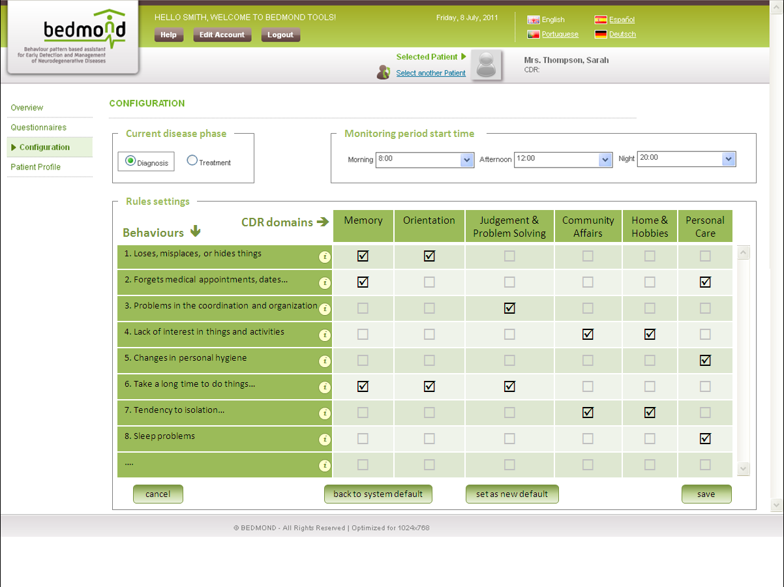
BEDMOND PROJECT SCOPE Interacting Tools – Health Professional

Slide 28
BEDMOND PROJECT SCOPE Interacting Tools - Caregiver

Slide 29
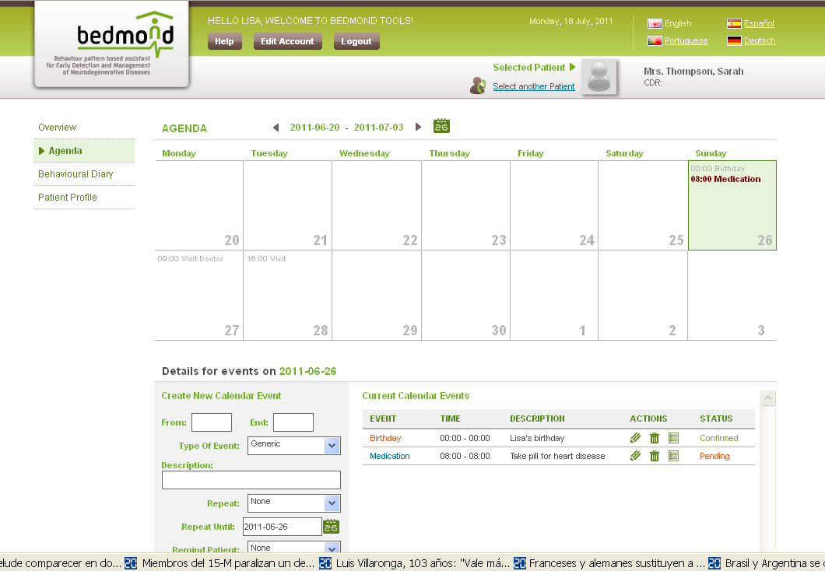
BEDMOND PROJECT SCOPE Interacting Tools - Caregiver

Slide 30
BEDMOND PROJECT SCOPE Interacting Tools - Caregiver

Slide 31
BEDMOND PROJECT SCOPE Interacting Tools - Elder

Slide 32
CONCLUSIONS Contributions
USER-centric (elder, key actor; doctor, main target user)
Off-the-self sensors & actuators and open middleware (integrability with commercial solutions for domotics & tele-assistance based on standards)
Standards (interoperability)
Open architecture (modularity, expandability)
Info interpretation (health professional rules)
Info presentation (user adaptive)

Slide 33
CONCLUSIONS Next Steps
Improve algorithmic models for ADL recognition
Smart technologies:
Indoor & Outdoor
Sound & Speech
Smart-home Advanced sensors (motes)
Affective technology (emotion & stress)
Location & Identification: Persons & Objects (smart objects)
...
Integration w/ Daily Assistants & Home Automation
Caregivers Assistance (technology-based)

Slide 34
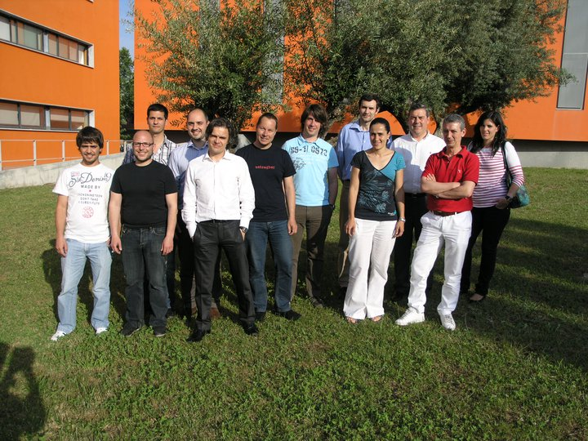
Thanks for your attention
· BEDMOND project team ·
Alberto Martínez Cantera
alberto.martinez@tecnalia.com
BEDMOND project coordinator
TECNALIA Research & Innovation
Health Technologies Unit
Acknowledge
BEDMOND consortium is formed by:
BEDMOND project is co-funded by the European AAL Joint Programme and the National Funding Agencies: FFG (Austria), MITYC y MICINN (Spain) and UMIC (Portugal)

