Slide 1
Fostering Care Cooperatives in Europe by Building an Innovative Platform with ICT-Based and AAL-Driven Services
CHALLENGE
Over the next 40 years the proportion of the population over the age of 65 in the European Union will double, rising from 17% in 2005 to 30% in 2050.
VISION The cooperative concept is already well-established and successful in domains such as food supply. Care Cooperatives
will encourage autonomous, regional
care systems empowered by
emerging information and
communication technologies.
O1
ELABORATE the foundation of iCareCoops to support and promote Elderly Care Cooperatives by conducting research on existing best-practice cooperatives in different domains (e.g. food).
STUDY concepts, approaches, and workflows of care communities in Europe, to achieve a sound understanding of services offered and requirements to support these services with ICT and AAL.
BUILD an innovative, web-based software solution, which offers interactive services, processes, and mobile applications to enable an environment of collaboration and cooperation.
O4
INTEGRATE existing AAL gateways, devices, and services on the platform serving as technical triggers for care actions and promote AAL solutions over an agent-based directory.
IMPLEMENT, demonstrate and validate iCareCoops in a realistic pilot environment which strongly involves care cooperatives, informal and formal carers, care receivers and other relevant stakeholders.
DEVELOP sustainable strategies for the rollout of Elderly Care Cooperatives in Europe including a service portfolio fostering elderly care efficiency and distribution of AAL solutions.
O2
O5
O3
O6

Slide 2
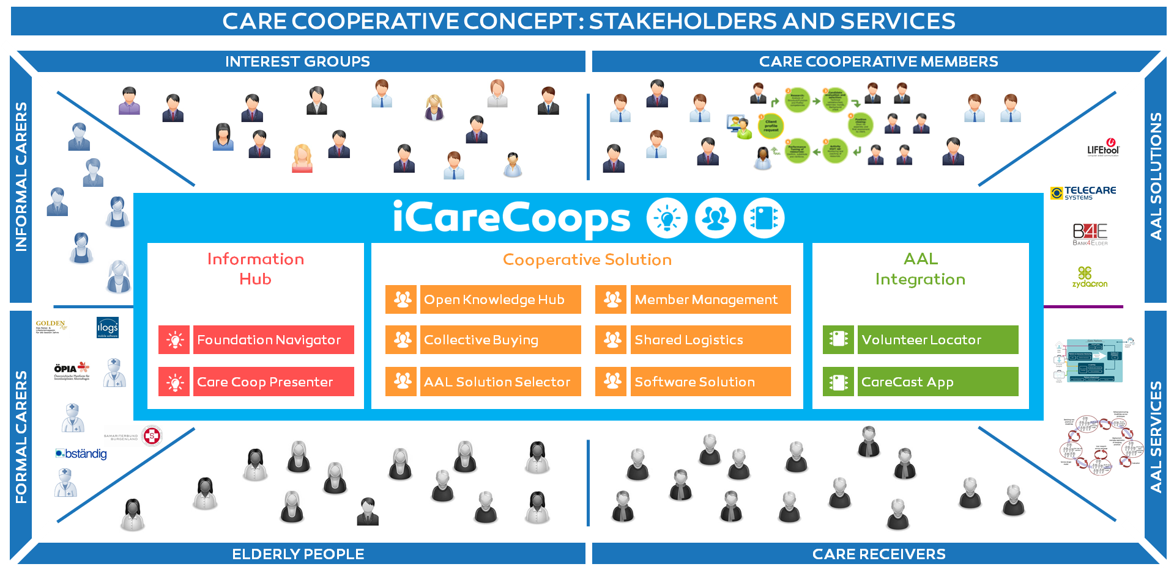
Fostering Care Cooperatives in Europe by Building an Innovative Platform with ICT-Based and AAL-Driven Services
Project Website project.icarecoops.eu
Contact office@icarecoops.eu
Project Duration 03/2015 – 06/2017
Programme AAL-2014 Care for the Future

