Slide 1
ICT as a tool for maintaining older people’s mobility
Fanny Le Morellec
Margarita Anastassova
José Lozada
Pierre Falzon
AAL 2013
24 – 26 September
Norrköping, Sweden
Referent ADEME: Gabriel Plassat - Service Mobility And Transport
Notes:
Hello everybody, my name is Fanny Le Morellec.
I’m Phd Student at Conservatoire National des Arts et Métiers to Paris, in France. My work is funded by the French Environment and Energy Management Agency and the French Office for Atomic Energy and Alternative Energies.
Today I will present my paper entitled ICT as a tool for maintaining older people’s mobility.

Slide 2
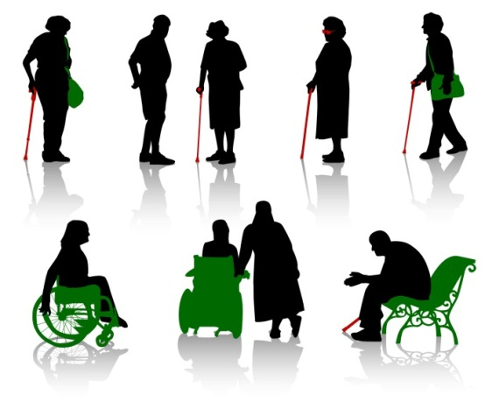
background
Effects of aging in mobility of older adults
Fisk, Rogers, Charness, Czaja and Sharit, 2004.
Potential accessibility vs Revealed accessibility
“By comparison with the revealed accessibility approach, the potential accessibility approach is more narrowly focused, the emphasis being upon the opportunity or potential for a certain type of behaviour rather than upon actual behaviour (Moseley 1979)”.
DECLINES
in
SPATIAL COGNITION

Slide 3
background
Internet and older adult’s: What did we expect for tomorrow ?
Individuals who use the internet on average at least once per week in Europe, 2011 (%)
Source: Eurostat. Gallais, A. (2012). Le rôle des nouvelles technologies en matière d’inclusion sociale: une vision européenne. Tech. rep., collection Working paper.

Slide 4
Objectives
Answer to questions:
What are the types of difficulty experience by older adults while mobile?
Outdoors and indoors
Intrinsic difficulties i.e. physical, cognitive, sensorial and physiological
Extrinsic difficulties i.e. environmental
How ICT can help older adults to cope with the difficulties?
New alternative itinerary:
Preparation
Realisation
Can give more information's for the navigation

Slide 5
Methodology – online questionnaire (2/2)
Older adults (234):
140 people aged between 50-64
76 people aged between 65-74
18 people aged 75 +
Questionnaire:
20 questions
Focus on data related:
The difficulties in mobility
The navigation support
FRENCH RESPONDANTS
DAILY MOBILITY
http://www.gart.org/Pratique-et-utile/Deplacements-qui-fait-quoi2

Slide 6
Results and discussion – online questionnaire

Slide 7
Results and discussion – online questionnaire

Slide 8
Conclusion – Work in progress
Environment is not the first resource used in mobility and it is the least used resource by the older adults.
ICT seem to be a potential of resources that could become a revealed source of resources
This study shows that usage of ICT increase with aging in mobility, therefore older adults of tomorrow could probably more familiar with ICT usage
So, ICT could help older adults to compensate age-related decline in mobility

Slide 9
Thank you for your attention
Mail: Fanny.LEMORELLEC@cea.fr

