Slide 1
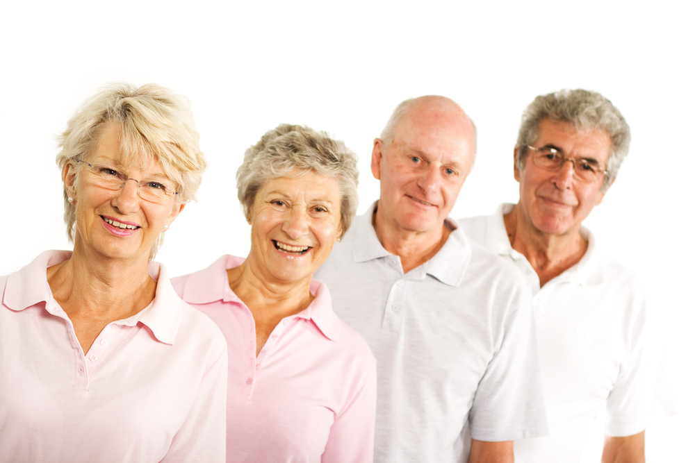
Strengthening Self-Management of Stress in Older Workers through Advanced Technology Apps: The StayActive Project
Luiza Spiru, Mirabela Ureche, Ileana Turcu,
Inmaculada Luengo, Michel Deriaz,
Diego Fuentes, Dani Blanco, Nitin Thakrar,
& members of StayActive consortium

Slide 2
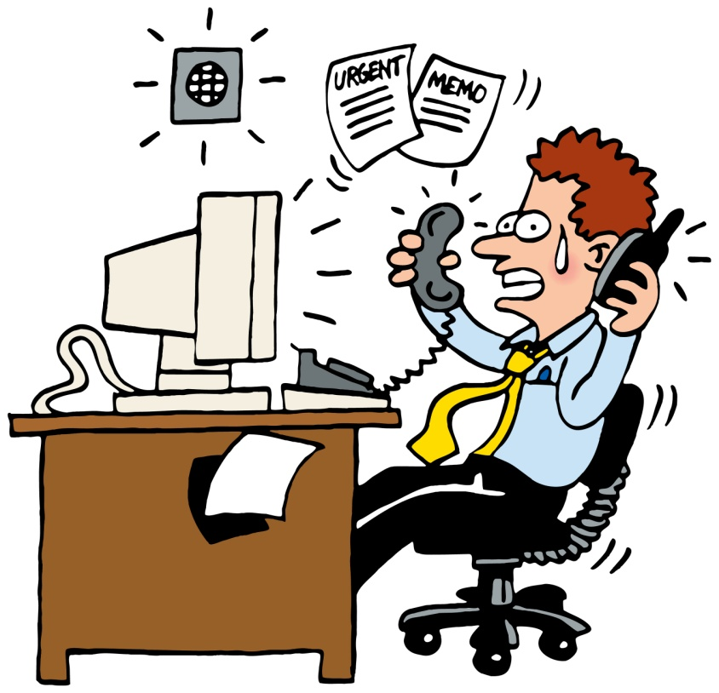
Background
A certain amount of stress can actually enhance performance and productivity [1].
Unhealthy, chronic stress
According to NIOSH:
40% of workers → consider their job as very stressful
25% → job is the number one stressor in their live
26% → often or very often burned out by their work
Job stress is more strongly associated with health complaints than financial or family problems.[1]
Older people chronically exposed to stressful environments are more prone to burnout, lesser productivity and onset of various illnesses [2].
Source: http://www.dreamstime.com/?gclid=CIHy1MSB58QCFTCWtAoddzwA5Q
Stress management
is a highly challenging must !
1. STRESS...At Work. The National Institute for Occupational Safety and Health (NIOSH). DHHS(NIOSH) Publication Number 99-101. http://www.cdc.gov/niosh/docs/99-101; 2. Thorsten Lunau et al., 2013. Work stress and depressive symptoms in older employees: impact of national labour and social policies. BMC Public Health 2013, 13:1086, http://www.biomedcentral.com/1471-2458/13/1086
Notes:
NIOSH - The National Institute for Occupational Safety and Health (NIOSH). http://www.cdc.gov/niosh/

Slide 3
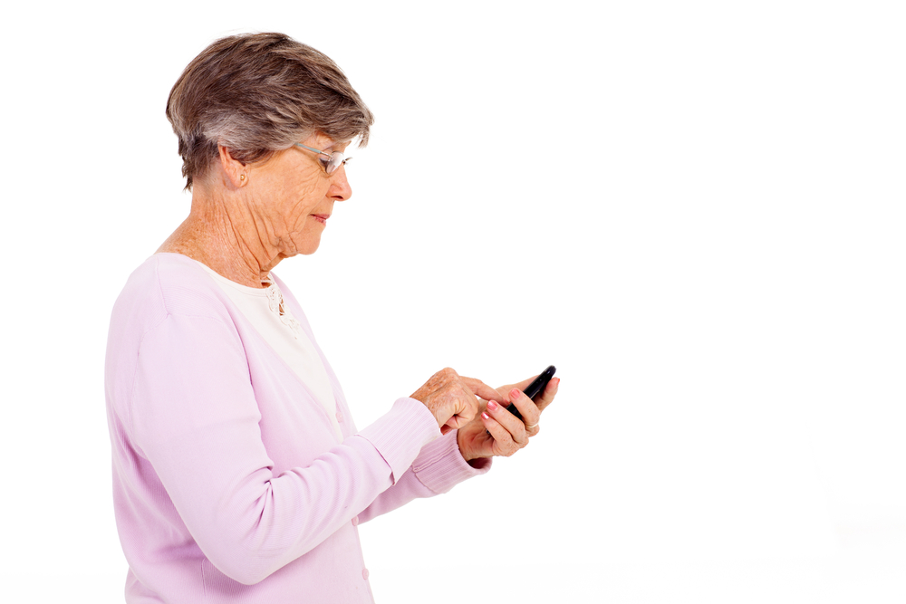
Stress management
Human-based
interventions and support
Advanced technology-based
support
medical staff, psychologists, institutional stress management specialists
smart apps able to detect stress level and
to provide helpful information and relaxation means for breaking the stressor
and counteract its effects
The development of advanced technology-based apps is essential for building the second, non-human assistance segment of health systems.
The StayActive project
aims at supporting older workers to cope with various stressors at their workplace through creating a smart app running on a smart phone and a web portal.

Slide 4
A multinational project, started in April 2014

Slide 5
StayActive approach
The target group
Older workers
(aged over 55), males and females, exposed to a stressful environment at their office or factory-like workplace,
Managers.
Detection and monitoring of user’s level of stress
Signaling of a critical stress level
Recommendation of various, highly personalized means for:
- breaking the action of the stressor,
- counteracting its effects,
- avoiding burnout
- improving productivity at work
A set of biosensors,
A Personal Agent installed on a smart phone
A clouding web portal

Slide 6
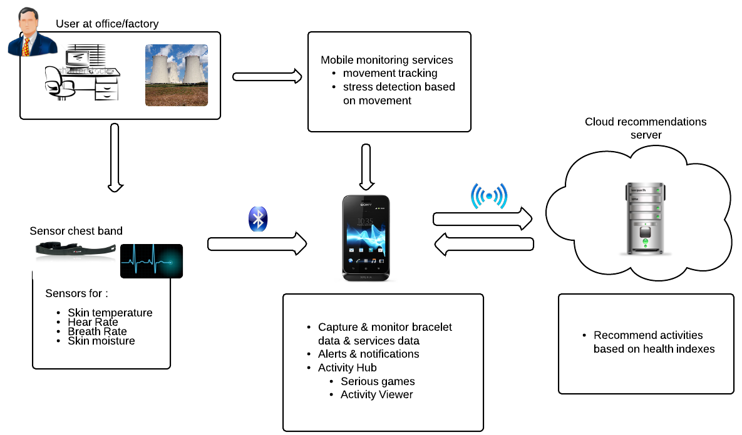
StayActive system’s architecture
User at office/factory
Mobility monitoring services
movement tracking
stress detection based on movement
Webportal
Sensor chest band
Biosensors:
Skin temperature
Heart rate
Breath rate
Skin moisture
Cloud recommendations server
Recommends activities based on health indexes
Capture & monitor bracelet
Alerts & notifications
Activity Hub
Serious games
Activity viewer

Slide 7
Services to be provided
by the StayActive app
Grace to biosensors (for heart rate, breath rate, skin temperature and moisture), and user’s movement tracking, this service is able to detect user’s stress state, its level, and to signalize it to the Webportal component and to the end user.
STRESS LEVEL DETECTION
This service will recommend various activities (e.g. take a break, read an article, watch a short video, listen to music, play a relaxation game) in the form of audio, video, images/slides and text based on the stress level detected.
RECOMMENDED ACTIVITIES
The service will show the current relaxation (or stress) level and also statistics about user’s daily/weekly activity (e.g., the graphics will show how active the user is on a specific day, what was the average heat rate daily/weekly, etc).
HISTORY
STRESS WIZARD
This service will be able to provide the user with various, highly personalized game-like and other activities, for helping him to break the action of the stressor and avoid its disturbing effects.

Slide 8
The current phase
of StayActive project development
The following tasks were accomplished:
Target group definition, end-user profiling
The setting up of ethical and legal aspects and control instruments
The selection of 40 voluntary end-users and their involvement by the two
national pilot sites (University of Geneva and Ana Aslan International Foundation – Bucharest, Romania):
- The Office group (older people working in stressful office-like environment)
- The Factory group (working in stressful factory-like environment)
- The Managers group (10 older people with team coordination tasks).

Slide 9
The current phase
of StayActive project development
Other accomplished tasks:
The specification of end users needs and preferences
The specification of StayActive system requirements (in progress)
The elaboration of the mock-up biosensors garments and prototypes and their
testing with the end-users (in progress)
The initiation of dissemination and exploitation plans.

Slide 10
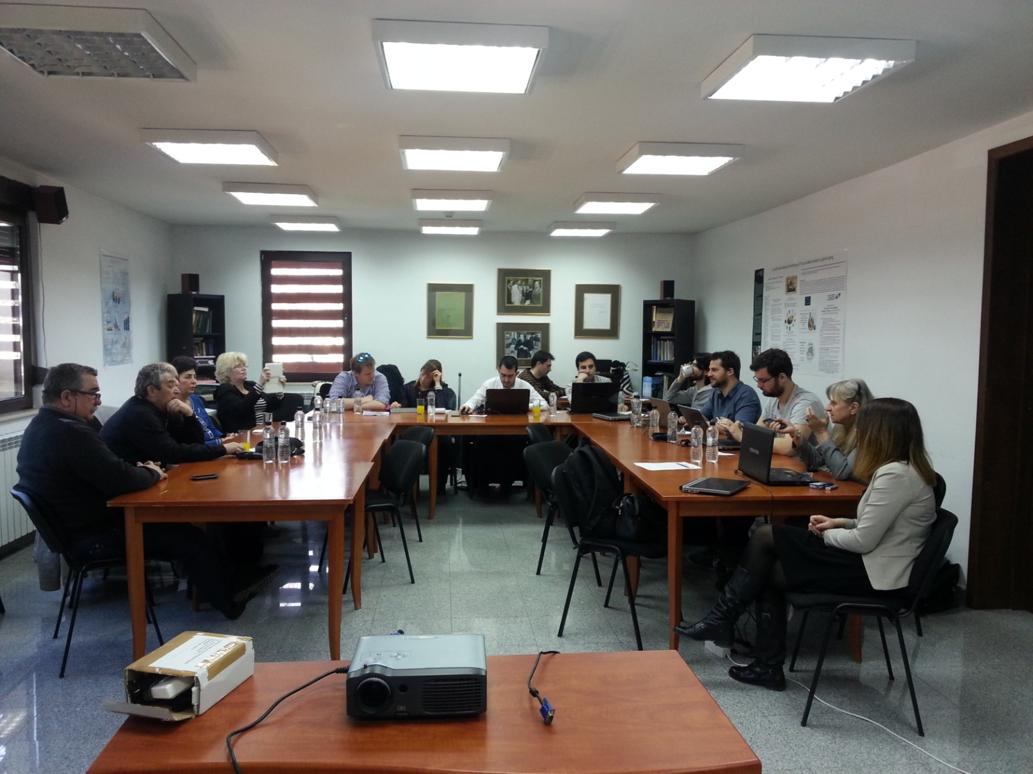
The sustained involvement of the voluntary end users
The above mentioned tasks were accomplished in close cooperation with the
voluntary end users
involved by the two pilot
sites, for assuring the two
capital requirements:
The user-centered
design
The personalization of RECOMMENDED
ACTIVITIES and
WIZARD services’
content.

Slide 11
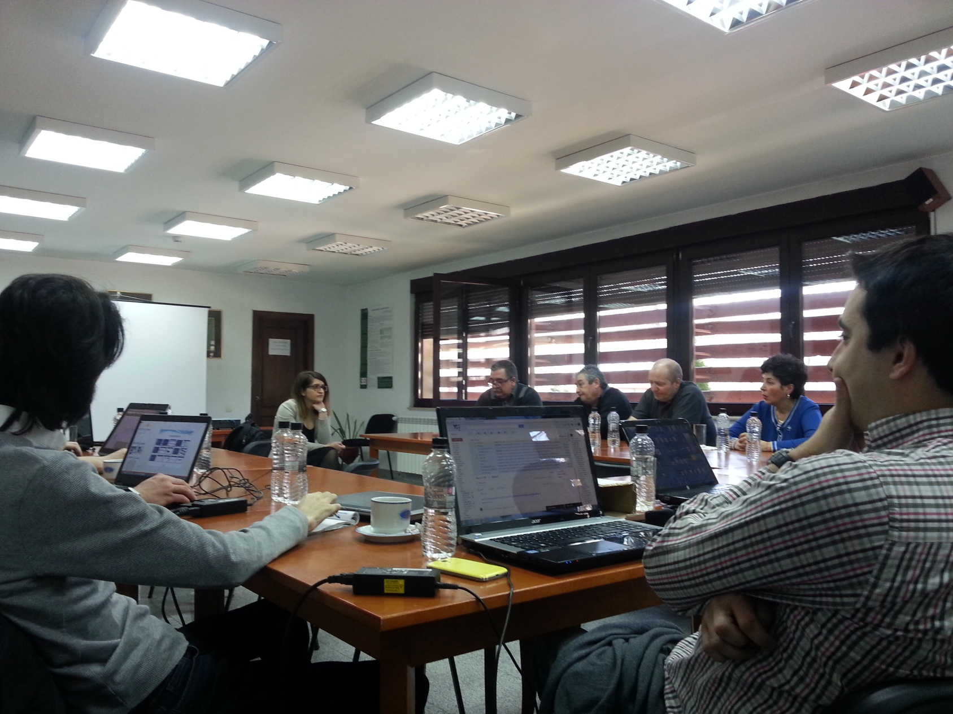
The next phases
of StayActive prototype development
The next action points will include:
The elaboration of the
1st , fully functional version of
the StayActive prototype
and its testing in real settings
with the end-users
The refinement of biosensors’ prototype
The elaboration and testing of the 2nd (beta) version of the
prototype
The design of exploitation
models

Slide 12
Main results and lessons learned
End users’ feedback denoted that:
Irrespective of users’ tech literacy or level of knowledge about stress, a smart tech “companion” able to support them fight workplace stress (and not only) will be highly appreciated.
The questioned managers proved very open to such a smart app able to help them to balance their concern about employees’ health and improvement of work security norms with that about demands of performance at work and profit.

Slide 13
Main results and lessons learned
The main challenges are to realize:
as much as possible friendly but highly intuitive interfaces,
simple, time saving ways of accession to a given service,
highly personalized content of recommendations and means to counteract stressful situations, depending on the individual’s profile, needs and preferences.
A particular challenge proved to be that of biosensors holder shape. Wearable biosensors were proposed, but other shapes were alternatively suggested by the end users and will be considered for the first, fully functional version of the prototype.
An additional challenge is that of motivating and keeping the end users to actively but voluntarily cooperate throughout the whole project running.

Slide 14
The envisaged impact of StayActive project
Benefits for the older workers and their managers (improvement of work security conditions and norms, improvement of health preservation through fighting unhealthy stress and counteracting its effects).
StayActive app can provide economical benefits:
through better controlling work environment,
diversifying labor protection norms,
improving the performance at work and reducing absenteeism etc.
By its philosophy and the solutions it provides, StayActive meets the requirements and actions promoted by The Strategic Implementation Plan of the European Innovation Partnership on Active and Healthy Aging launched by the European Commission in November 2011.

Slide 15
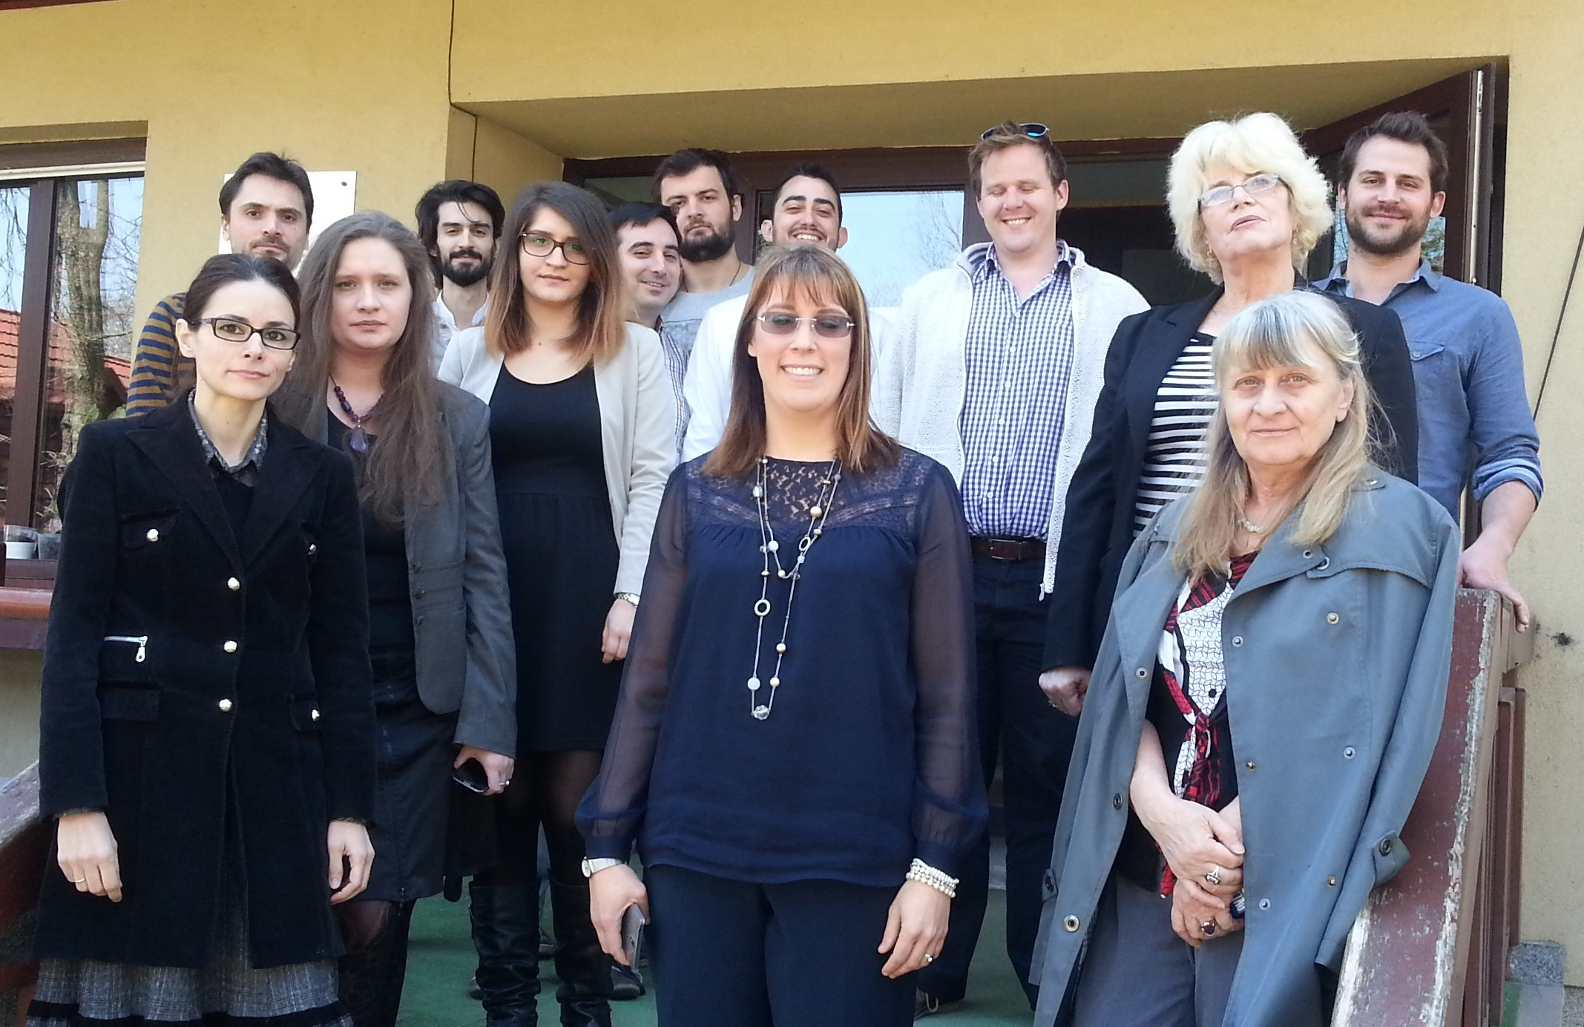
Thank you
for your attention and feedback !

